Slide 1
YOUR TRIP
PRESENTED BY
K.ROHITH KUMAR
K.HARI KISHAN
V.VISHNU CHAITANYA REDDY

Slide 2

THIS WEBSITE PROVIDES INFORMATION ABOUT TOURISM PLACESE IN THE WORLD & PROVIDES RESERVATION FACILITY

Slide 3
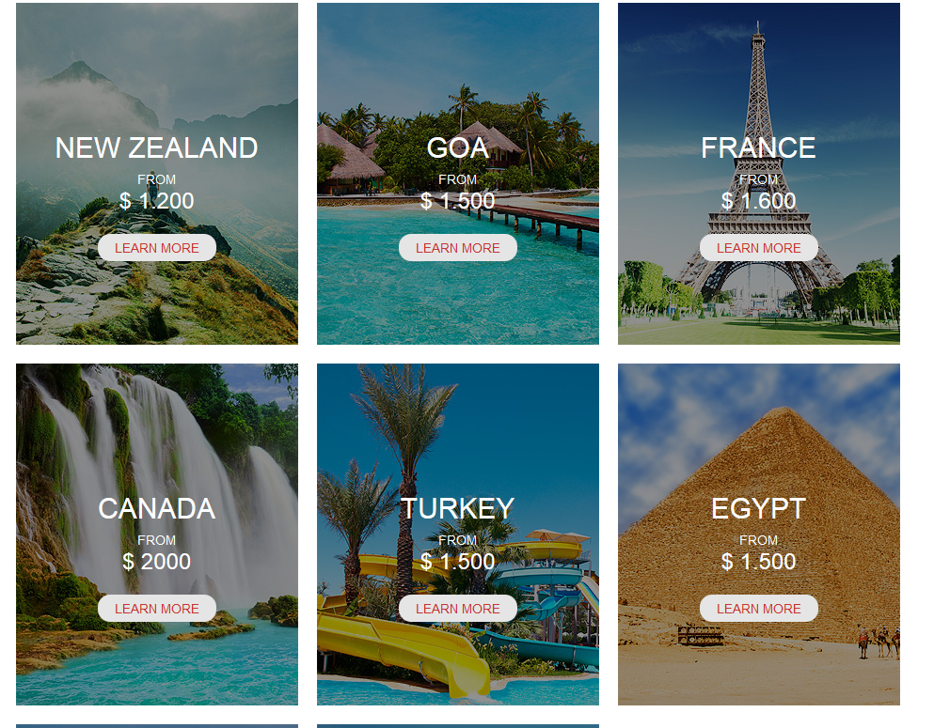
THIS PAGE PROVIDES DETAILS ABOUT PACKAGES

Slide 4
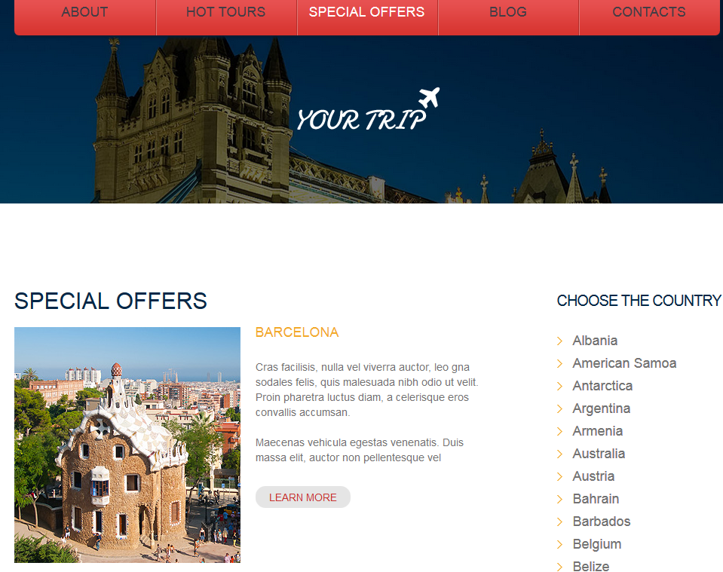
IT PROVIDES SPECIAL OFFERS OF A RESORTS

Slide 5
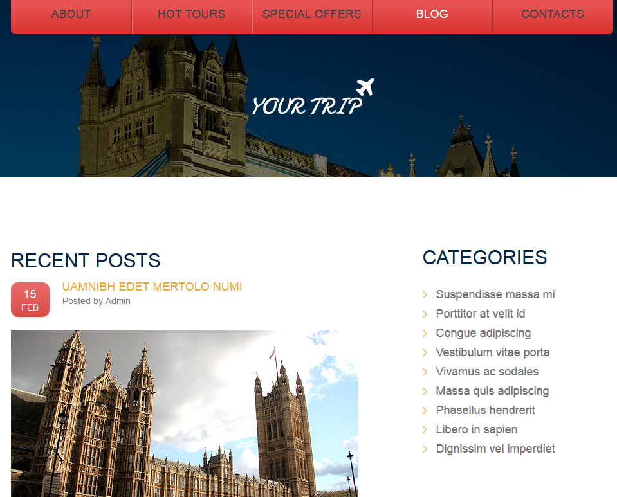
THIS BLOG CONSISTS SIGHTSEEING IN PARTICULAR PLACE

